Slide 1

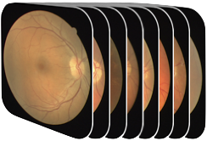

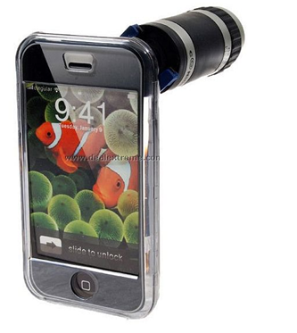
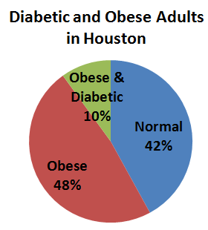
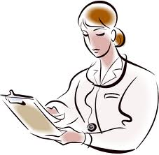
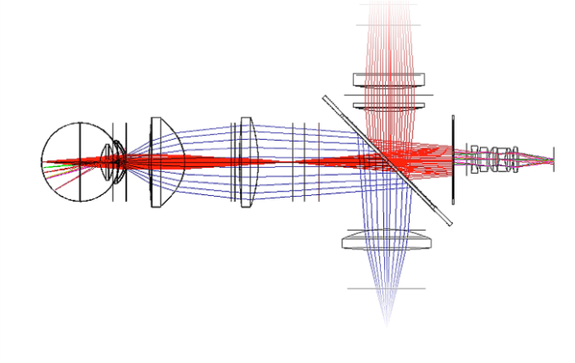
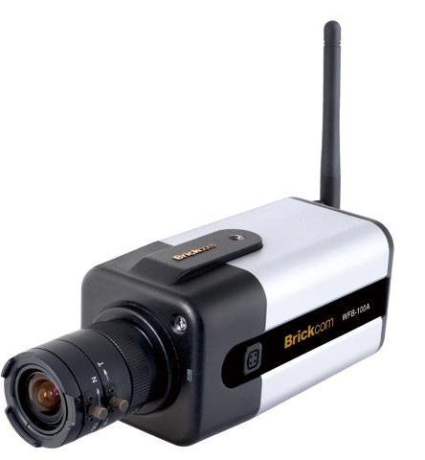
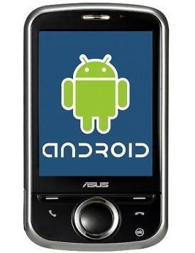
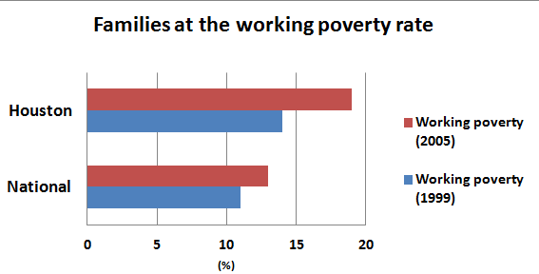


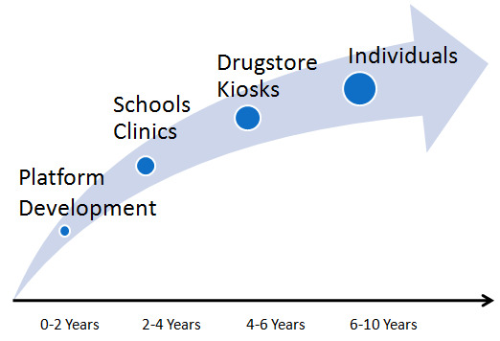


MobileVision: The Portable Eye Clinic
Kevin Beale¹, George Chen¹, Richard Latimer¹, Minhee Park², Adam Samaniego¹,
Gaurav Patel¹, Jason Porter³, Michael Twa³, Ashok Veeraraghavan¹, Gary Woods¹, Ashutosh Sabharwal¹
¹Department of Electrical Engineering, ²Department of Bioengineering, Rice University, ³UH School of Optometry
Eye Health in Houston
Engineering Design
Eye Health in America
1/4 of children and 1/3 of seniors have vision problems
Uncorrected visual impairment: > 11 million
Glaucoma: > 2.3 million (Another 2 million are undiagnosed)
Age-related Macular Degeneration: > 12 million
Diabetic retinopathy: > 4.4 million (1.5 million are undiagnosed)
System Design Goal
To design a portable, easy-to-use, cost-effective optometric system that can detect the most common visual impairments
Autorefractor Side
Refractive status (nearsighted/ farsighted)
Astigmatism
Pupil size + Cross eyed
Neurological Disorder
Retinal Imager Side
Retinopathy prescreening
Glaucoma
Diabetic retinopathy
Age-related macular degeneration
+
Patient history
New data
Many Houston Residents are at Risk of Vision Problems
MobileVision Analysis
High percentage of obese people
58% of Houston people are obese and 10% are diabetic
High percentage of elderly population
- 25% is aged 50 and older
High risk
Low risk
MobileVision mock-up
✔
Expert
Regular Eye Exams are Not Feasible
Few people are aware of the importance of regular eye exams
However, eye exams are expensive
Opto-Electronics Design
Electronic Interface Design
Processing Platform Design
Self-contained lens modules
Refractive error
Retinal imaging
Seamless electronic interface
- Link smartphone and optical front-end
Extensible image processing app
Communicates with IP Camera
Abstract necessary algorithms
Make vision screening intuitive
Deployment in Houston Area
Schools and Clinics
Design Drivers
Schools can regularly prescreen students’ vision
Educate people about the importance of eye prescreening
Clinics can deliver eye exams at a low cost
Current Diagnostic Tools |  | MobileVision Platform
Expensive and immobile |  | Affordable and portable, conserving high accuracy
Need to visit doctor’s office |  | Accessible at various locations. Raise public awareness of the importance of eye prescreening
Technician required |  | No trained technician needed
Drug Stores
Drug stores buy kiosks
Kiosks at drug stores increase the accessibility of eye ..exams to public even more
Individuals
Impacts of MobileVision platform for the Houston community
Make eye exams readily accessible to the public
- High risk people are regularly prescreened
Make inexpensive eye exams available
- Low-income families can have eye prescreening
Improve ocular and general health of Houston residents
Individuals at high risk of a certain ocular diseases can ..buy the MobileVision device and perform regular checks ..on their own

